Slide 1
Greedy Algorithm

Slide 2
Definition
Greedy algorithms seek to optimize a function by making choices (greedy criterion) which are the best locally but do not look at the global problem,
In simpler words, a greedy algorithm builds up the solution of a problem piece by piece, always choosing the next piece that offers the most obvious and immediate benefit.
Hence the result produced is a good solution but not necessarily the best one available, hence the solutions that are produced are very close to the optimal value.

Slide 3
Example
This is a scenario where the goal is to reach the largest sum by traversing through the tree.
At each step, the greedy algorithm will choose what appears to be the optimal immediate choice
It starts at the root node, and chooses 12 instead of 3 as the greatest, and hence not being able to reach 99 and achieve the goal
This shows how the greedy algorithm strives on providing the simplest solution and hence gives a solution that is close to the optimal value

Slide 4
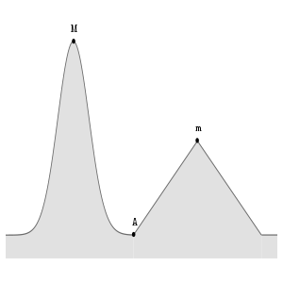
Example
Another example of Greedy Algorithm is finding the maxima by following the curve with the greatest slope
Starting from A, it achieves its condition by proceeding onto the local maxima at “m”, oblivious to the global maxima at “M”

Slide 5
Problem Statement
Given an array of size n that has the following specifications:
Each element in the array contains either a policeman or a thief.
Each policeman can catch only one thief.
A policeman cannot catch a thief who is more than K units away from the policeman.
Find the maximum number of thieves that can be caught
Answer to this is implemented in “Policeman-Thief.py”

